Slide 1
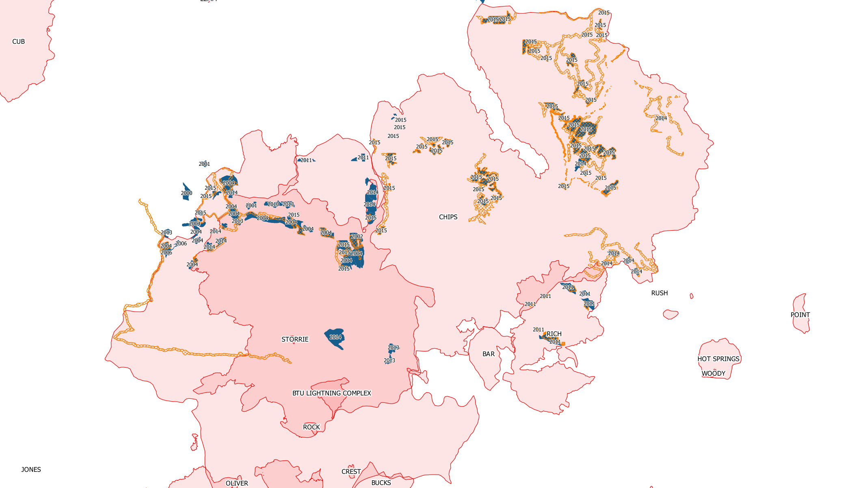
Chips, Rich, Storrie overview
Red is fire, blue is planting (with year), orange cross-hatch is salvage

Slide 2
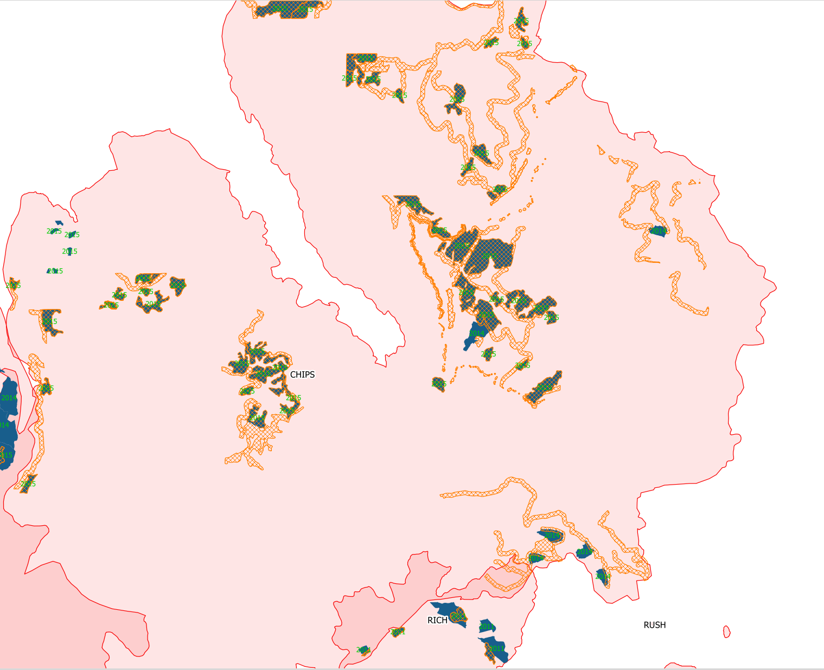
Chips closeup
Red is fire, blue is planting (with year), orange cross-hatch is salvage

Slide 3
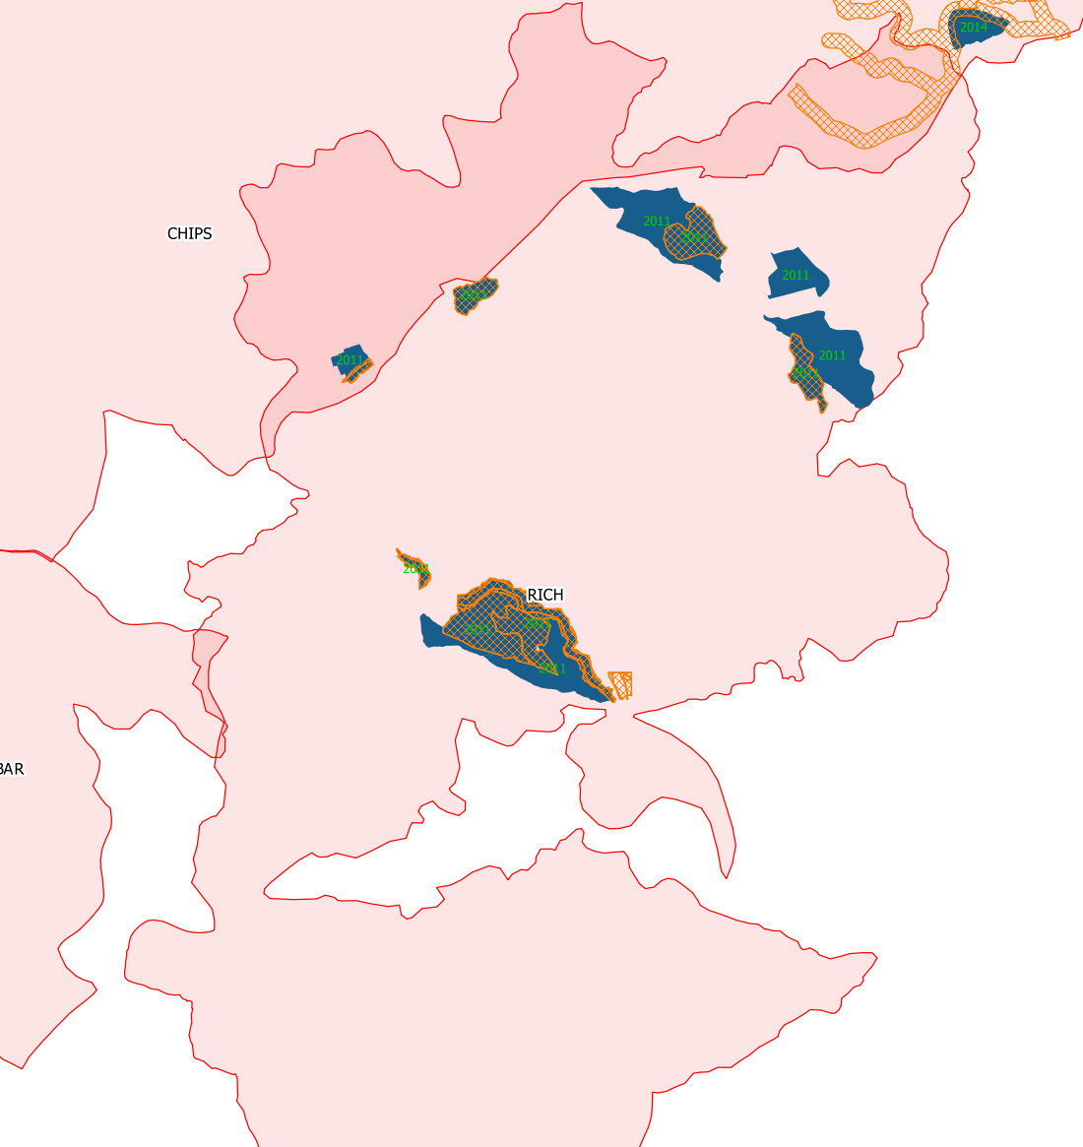
Rich closeup
Red is fire, blue is planting (with year), orange cross-hatch is salvage

Slide 4
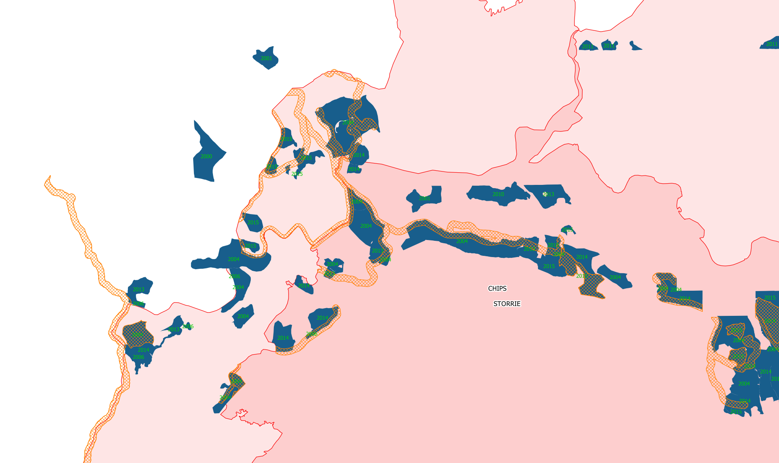
Storrie closeup (darker red is overlap with Chips)
Red is fire, blue is planting (with year), orange cross-hatch is salvage

Slide 5
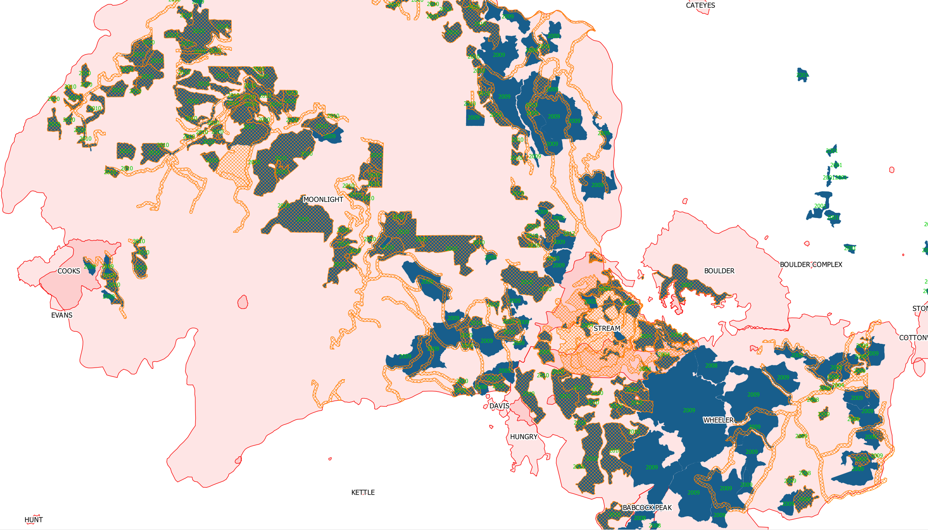
Moonlight, Antelope (aka Wheeler), Boulder, Stream
Red is fire, blue is planting (with year), orange cross-hatch is salvage

Slide 6
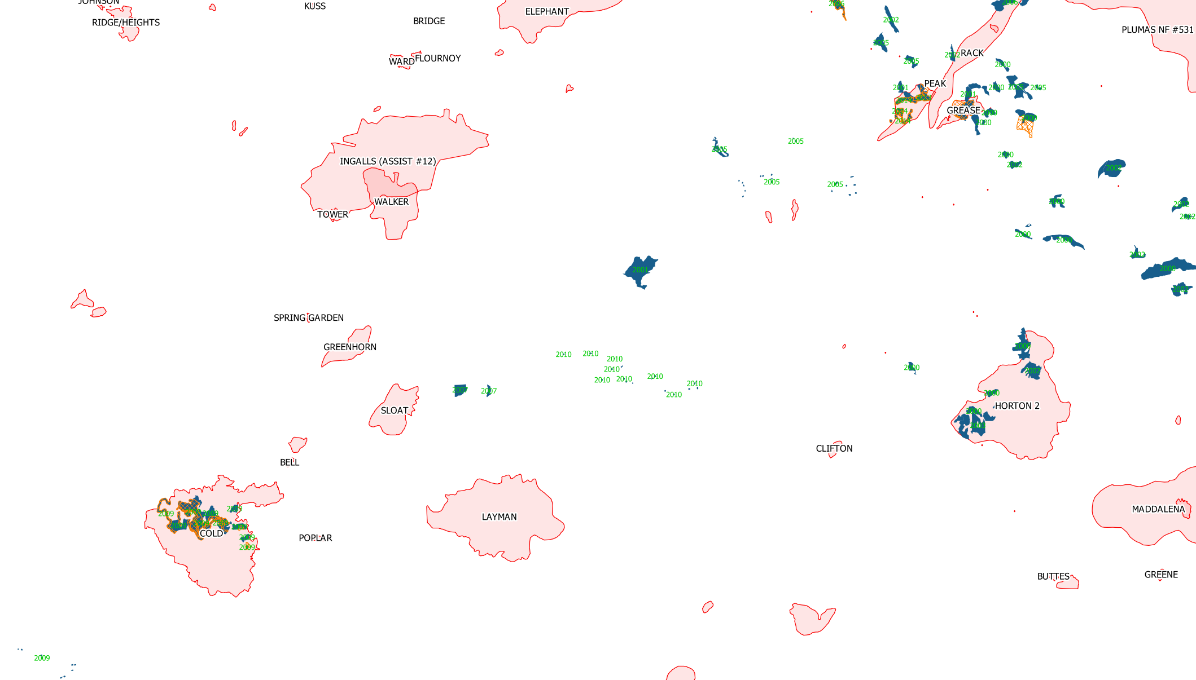
Peak, Grease, Cold
Red is fire, blue is planting (with year), orange cross-hatch is salvage

